Slide 1

Delayer
2003
-
2005
Annydaves’Auto
AnnyDave’s Autos is a wholesale business/organization that deals majorly on sales of vehicles of all types .
Olusanya Oluwatosin Abel

Slide 2
Delayer
Objectives
04
Determine the impact of deal size on sales and revenue distribution across customer segments.
03
Investigate regional performance variations in revenue, unit sales, and customer count to pinpoint expansion opportunities.
02
Analyze sales growth trends (yearly) with KPIs including total revenue, total orders, highlighting top products and customer segments driving revenue.
01
Evaluate the global footprint with KPIs like total countries reached and revenue by region, identifying regions with strong sales and potential for growth.

Slide 3
Delayer
Methodology
01
Data Source
The dataset was sourced from AnnyDaves’ Autos company.

Slide 4
Delayer
Data Cleaning
Created a data model with three dimension tables (Geography, Customer, Product) and one fact table (SalesFact).
Converted the date column from text to a date format using the "Using Locale" function. Also created a date table using DAX function.
Removed duplicates and blank/error rows from all dimension tables, while preserving the fact table as-is.
Tools used: Powerbi, Excel, and PowerPoint
Established primary keys (Geography ID, Customer ID, Product ID) for the respective dimension tables to ensure data integrity.

Slide 5
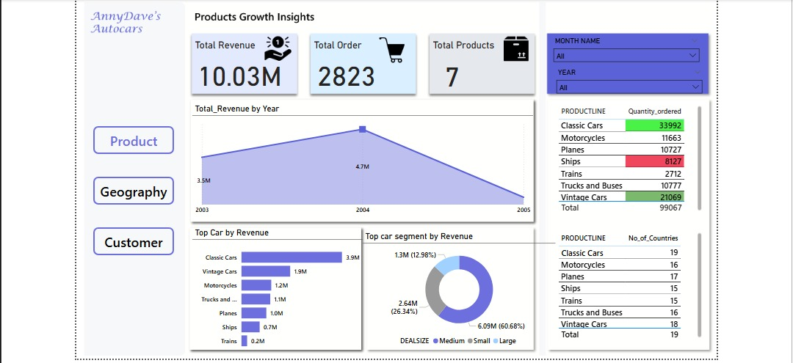
Product Overview

Slide 6
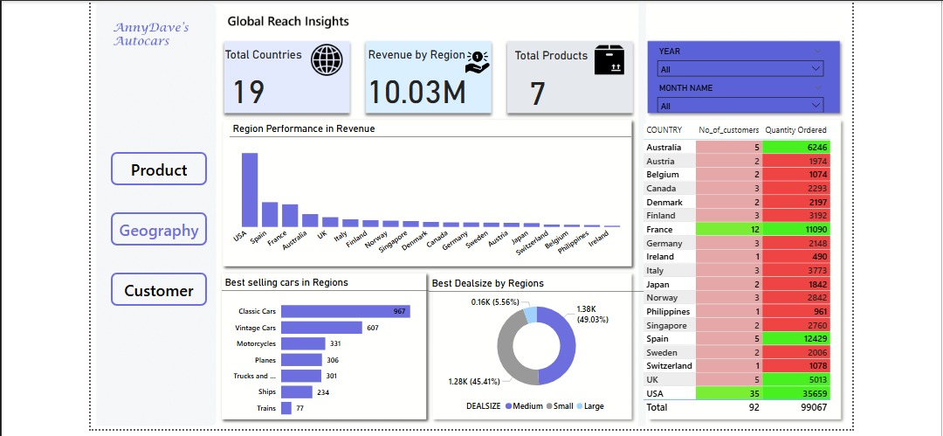
Global Overview

Slide 7
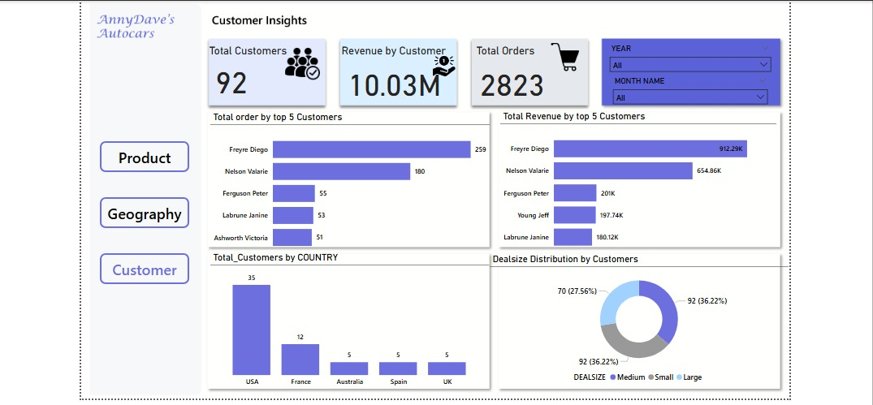
Customer Overview

Slide 8
Delayer
01
Global Insights
Analyzes regional revenue, top cars, deal sizes and global product distribution.

Slide 9
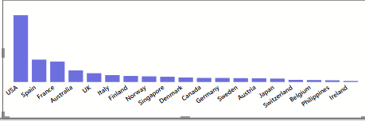
Delayer
Region Performance in Revenue
Region Performance in Revenue
USA led, followed by Spain and France, indicating robust regional sales performance.

Slide 10
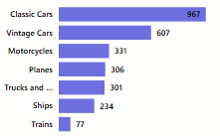
Delayer
Best Selling Cars in Regions
Best Selling Cars in Regions
Classic Cars (967 units), Vintage cars (607), and Motorcycles (331 units) were top sellers, driving regional success.

Slide 11
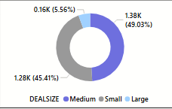
Delayer
Best Deal Size by Regions
Best Deal Size by Regions
Medium (49.03%) and Small (45.41%) dominated, aligning with customer deal size trends.

Slide 12
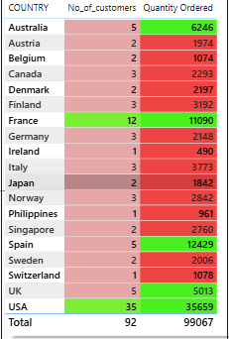
Delayer
Country No. of Customers & Quantity Ordered
Country No. of Customers & Quantity Ordered
France (12 customers, 11090 quantity) and USA (35 customers, 356K quantity) led, showing high engagement.

Slide 13
Delayer
02
Customer Insights
Details top customers, regional distribution, revenue, and deal size preferences.

Slide 14
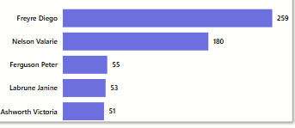
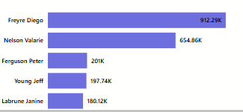
Delayer
Total Orders by Top 5 Customers
Total Orders by Top 5 Customers
Freyne Diego (259 orders) led, followed by Nelson Valarie (180), indicating key customer drivers.
Total Revenue by Top 5 Customers
Total Revenue by Top 5 Customers
Freyne Diego ($913K) topped revenue, with Nelson Valarie ($654K) close behind, highlighting elite customer impact.

Slide 15
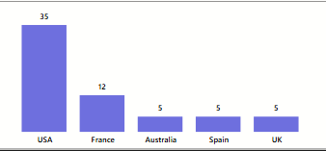
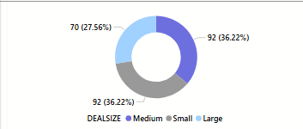
Delayer
Total Customers by Country
Total Customers by Country
USA (35) and France (12) dominated customer bases, reflecting strong regional loyalty.
Deal Size Distribution by Customers
Deal Size Distribution by Customers
Medium (36.22%) and Small (36.22%) outpaced Large (27.56), suggesting a preference for larger deals among customers.

Slide 16
Delayer
03
Products Insights
Covers revenue, quantity sold, and country reach by product line.

Slide 17
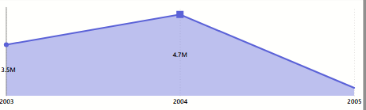
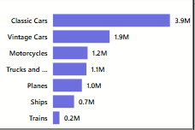
Delayer
Total Revenue by Year
Total Revenue by Year
Revenue peaked at $10.03M in 2004 with a 4.7M revenue, showing a strong growth trend from 2003, indicating a peak sales year.
Top Car by Revenue
Top Car by Revenue
Classic Cars ($3.9M), Vintage cars (1.9M), and Motorcycles ($1.2M) led revenue, highlighting their dominance in the product lineup.

Slide 18
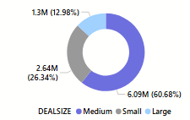
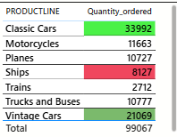
Delayer
Top Car Segment by Revenue
Top Car Segment by Revenue
Deal Size Medium (60.68%) and Small (26.34%) drove revenue, with Medium being the key segment for growth.
Product Quantity Ordered
Product Quantity Ordered
Classic cars (33,992) and Vintage Cars (21,069) topped orders, reflecting high demand for these categories.

Slide 19
Delayer
Recommendations
Promote Top Products:
Target High-Revenue Regions
Focus marketing on USA, Spain and France to sustain regional dominance.
Boost Classic Cars (967 units, $3.9M), Vintages (608 units, $1.9M), and motorcycle (311 units, $1.2M) to capitalize on demand.
Expand to High-Potential Areas
Encourage Medium Deals
Target regions with low revenue like Canada, Germany, Sweden, Austria to Ireland, for expansion.
Leverage the Medium (36.22%) and Small (36.22%) deal size preference to increase order values.
Engage Key Customers
Offer incentives to Nelson Valarie (180) and Freyne Diego (259 orders) to maintain loyalty.

Slide 20
Delayer
Conclusion
The 2003, 2004, 2005 sales data peaked at $10.03M, driven by Classic Cars ($3.9M) and Vintage car ($1.9M), with USA ($3.6M) revenue and USA (35 customers) leading regions. Medium deal sizes (60.68%) and top customers like Freyne Diego ($913K) fueled growth. Strategic focus on key products, regions, and customers can drive future success.

Slide 21
Delayer
Thank you.
2003
-
2005

